Slide 1
Spring Boot – Role Based Security with JAX-RS Annotations
We will create JAX-RS 2.0 REST APIs using Spring Boot and Jersey framework, and add role based security using JAX-RS annotations e.g. @PermitAll, @RolesAllowed or @DenyAll.

Slide 2
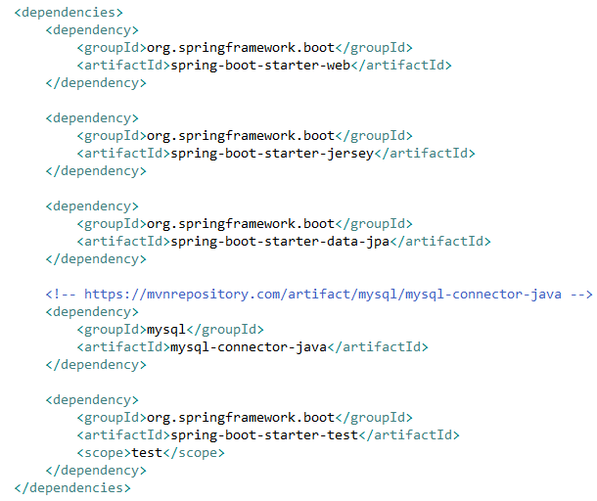
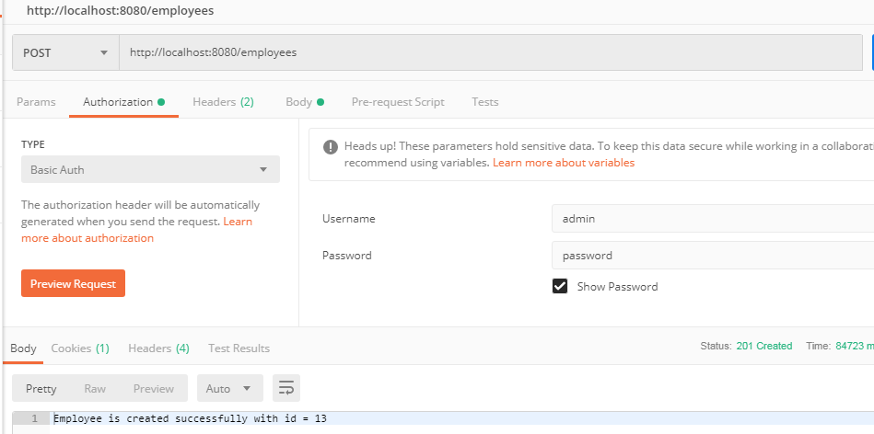
Spring Boot – Role Based Security with JAX-RS Annotations
https://howtodoinjava.com/spring-boot/role-based-security-jaxrs-annotations/

Slide 3
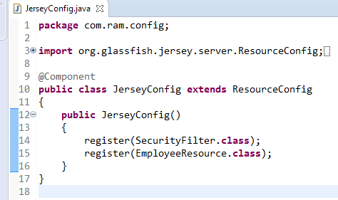
Spring Boot Jersey Example
Now we have a JAX-RS resource and we want to access it from spring boot application which include Jersey dependency. Let’s register this resource as Jersey resource.
Look at the @Component annotation. It enables this class to be registered while spring boot auto scans the java classes in source folder.
ResourceConfig provides advanced capabilities to simplify registration of JAX-RS components.
SecurityFilter class is the actual auth details processor
Security Filter
Security filter which will examine the incoming requests, fetch the authorization information (basic auth in this example), and then will match user name and password, and finally it will verify the user’s access level by it’s role. If everything matches, API will be accessed else user will get access denied response.

